Slide 1


The SHAREMED Study Site
concept and portals
University of Malta – Sicily Channel Study Site
Portal
Dr Anthony Galea
Oceanography Malta Research Group
Programme co-financed by the
European Regional Development Fund
Programme cofinancé par le Fonds
européen de développement régional

Slide 2

Sicily Channel Study Site
PORTAL sharemed.ocean.mt/sicilychannel
4.4.1 - Common portals for the transnational pilot sites
[Nikola Krlovic, Audrey Zammit, Anthony Galea]
University of Malta designed and setup an operational portal for the Sicilian Channel, prepared data layers for the portal, executed innovative product delivery components on this portal.

Slide 3
The SHAREMED Interface
Purpose
  To give real time data with respect to parameters
  To present a space for comparative viewing of separate models applied on the Sicily Channel
  To provide point data and measurement values from buoy measurements
    This all contributes to the overall premise of the SHAREMED project with respect to data sharing!

Slide 4
The SHAREMED Interface
Technological aspects
The website is build using the OpenLayers library for GIS development
  State of the art functions and ease of modification
The data are generated with the server of UoM and are distributed to the interface via GeoServer – an open source server specializing in GIS data.
  Allows for simple configuration, viewing and changing of paratmeres
  Has automation as one of its core functions

Slide 5
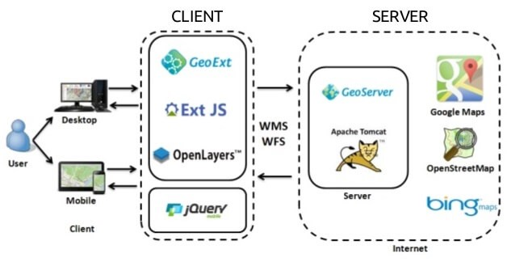
The SHAREMED Interface
This is us!
This is you!
Source : https://miro.medium.com/max/628/0*mdVRJBXH_ihVsfiV.jpg

Slide 6
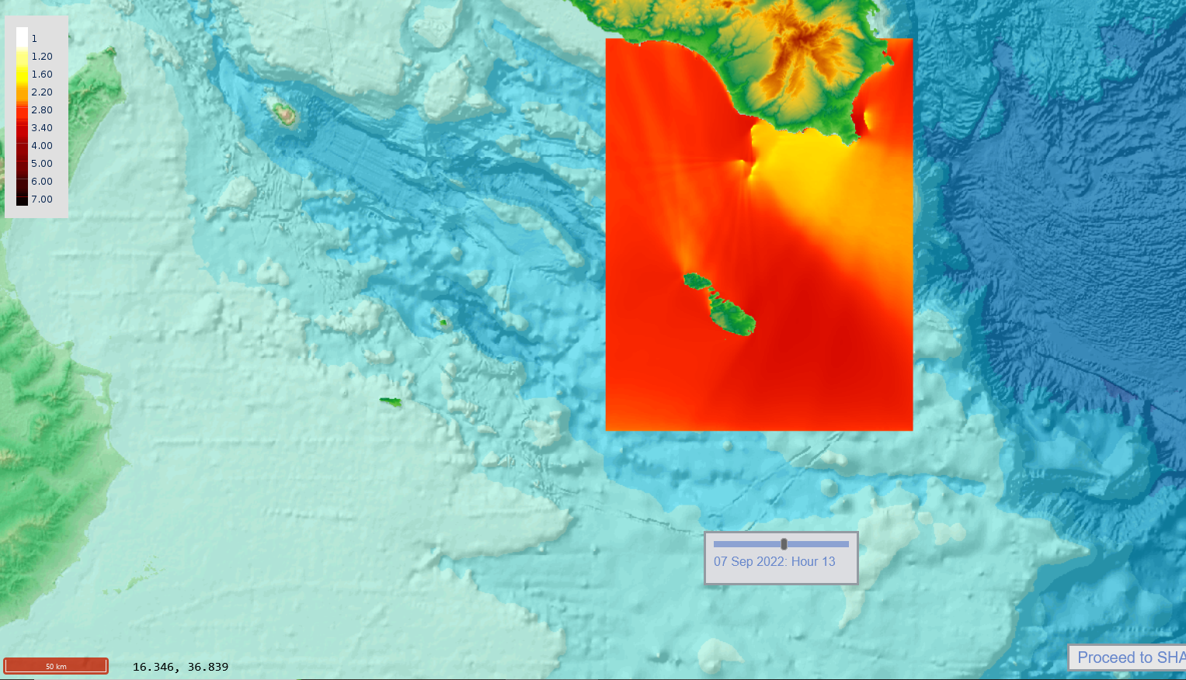
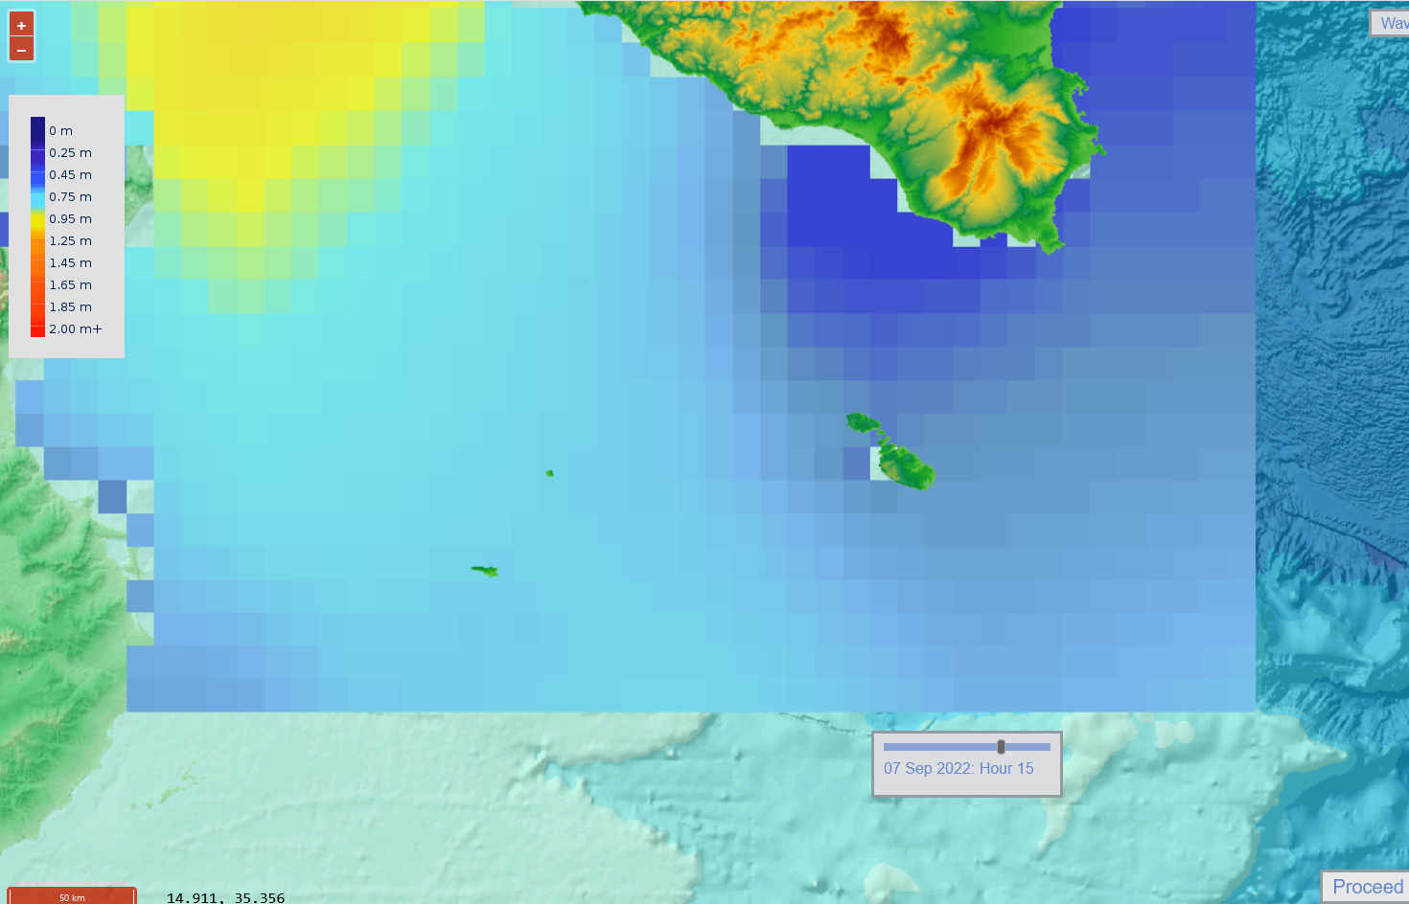
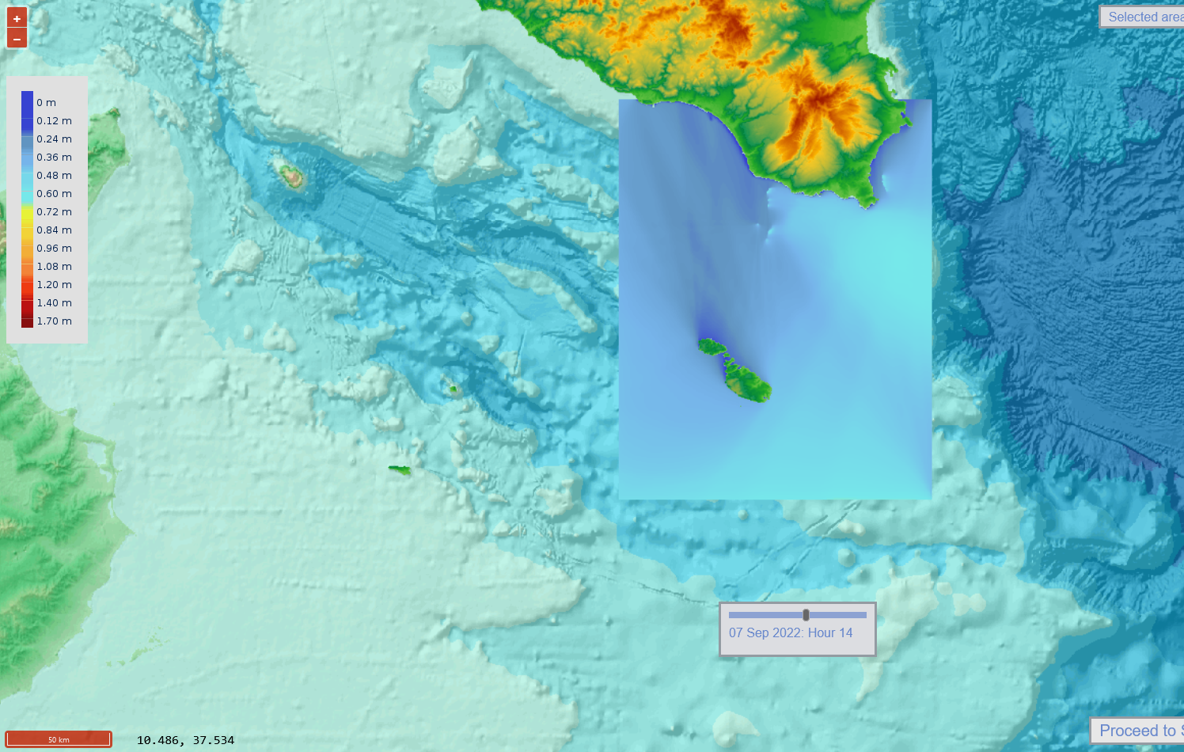
Why Compare?
Models differ based on their parameters and purpose of applications
  In the case of SHAREMED, they differ in geographical boundaries and resolutions as well
  Different models expect different viewers, and that is why we share what we can.

Slide 7
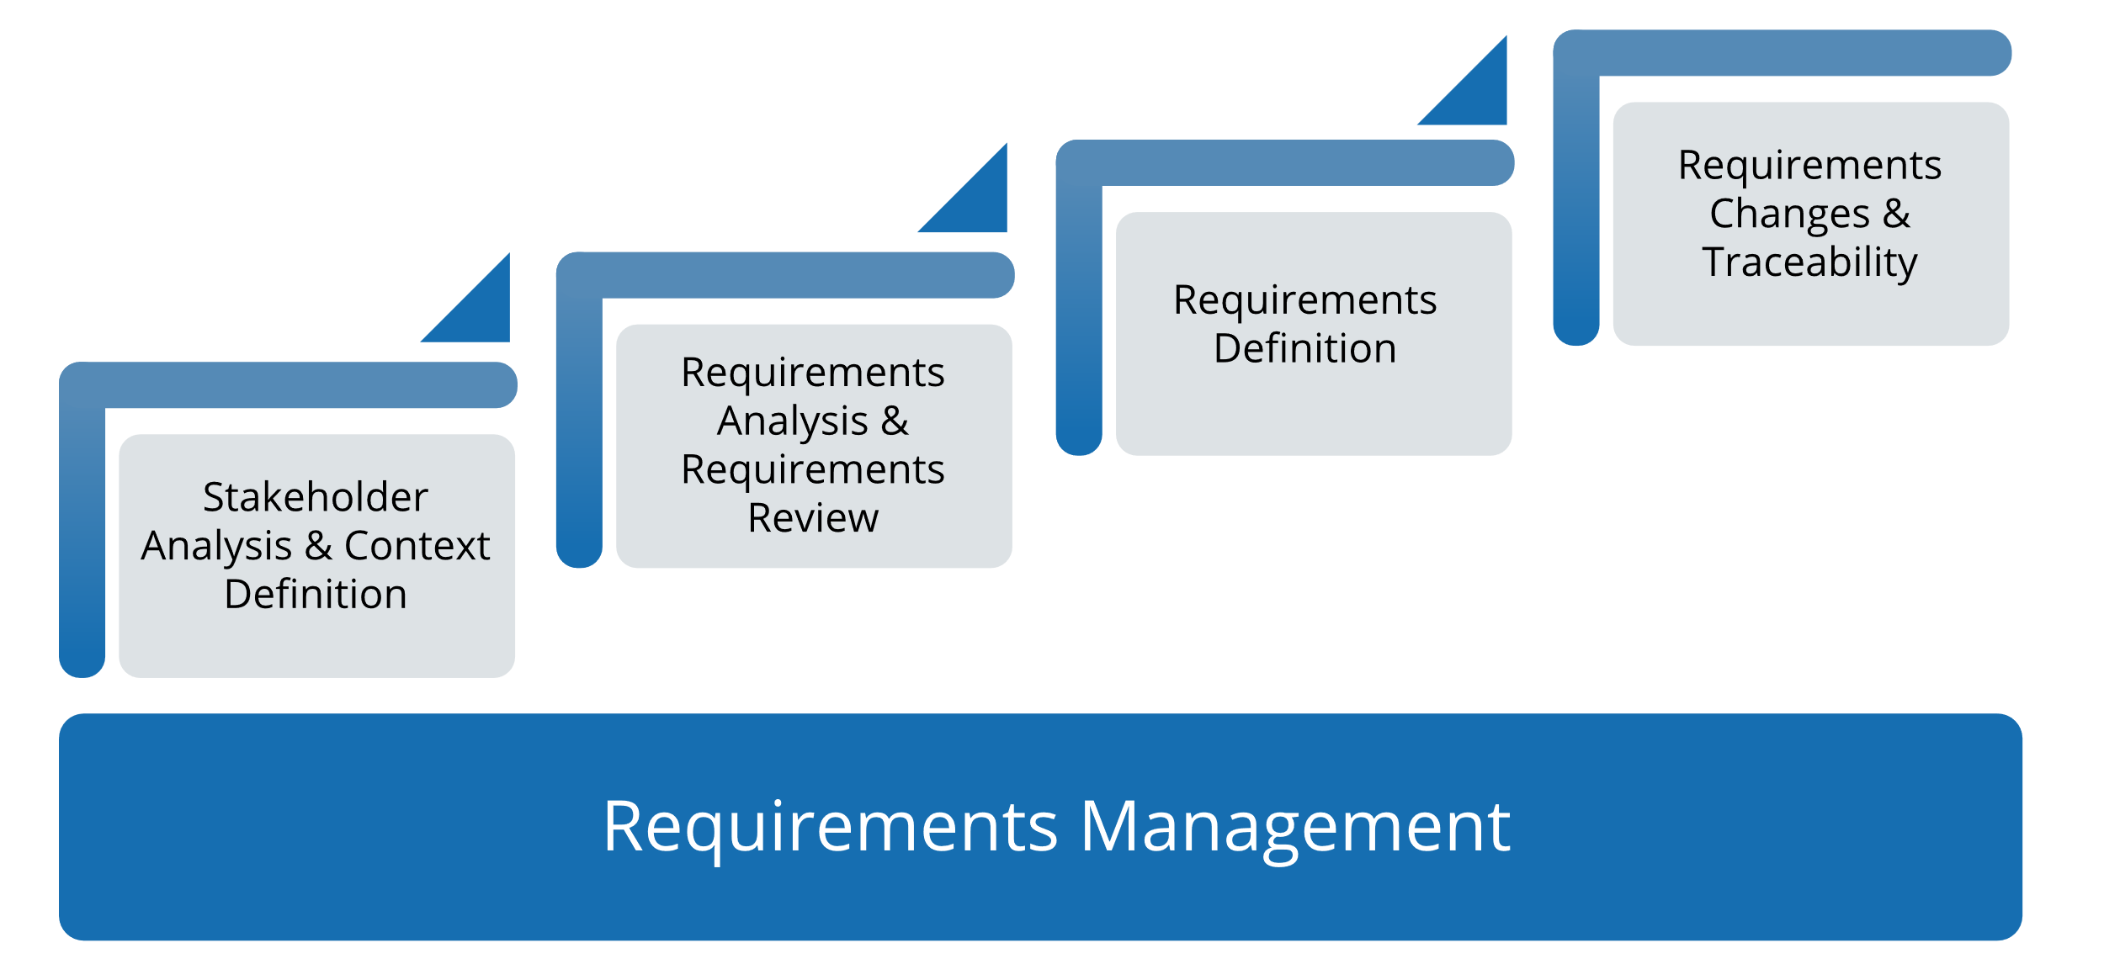
This was built with the user in mind
Everything, from the beginning to the end, was built using IT management principles of requirements engineering, where the user was put in the focus of the product.
Source : https://www.microtool.de/wp-content/uploads/2020/06/requirements-management-en.svg

Slide 8
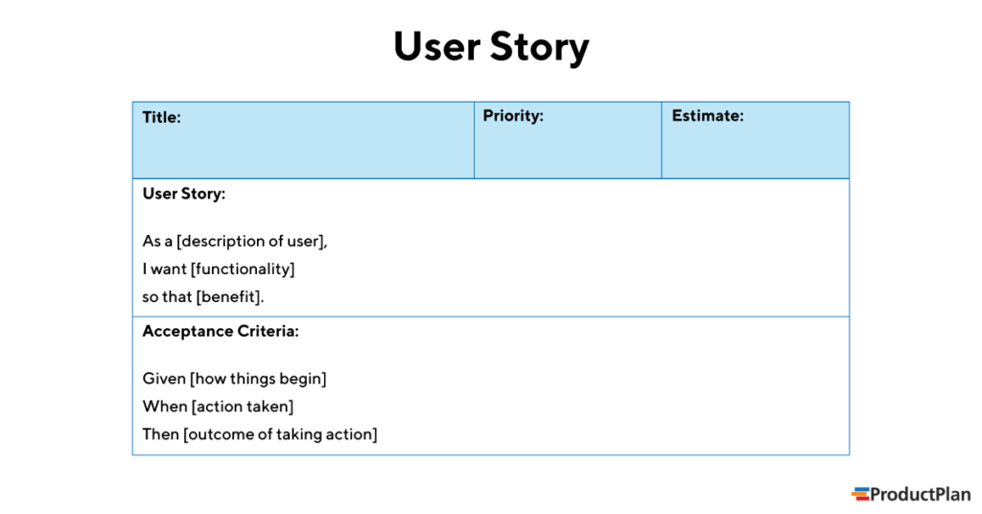
This is an iterative process…
  We ask the audience to take a look at our interface, ignore the current issues, and ask yourself the questions with the principle of requirements engineering
  https://sharemed.ocean.mt/sicilychannel/
  The story (above), is
  the user’s requirement
  The AC (below) is how
  this requirement is finally
  completed
Source : https://www.productplan.com/uploads/2019/01/user-story-1024x536.png

Slide 9
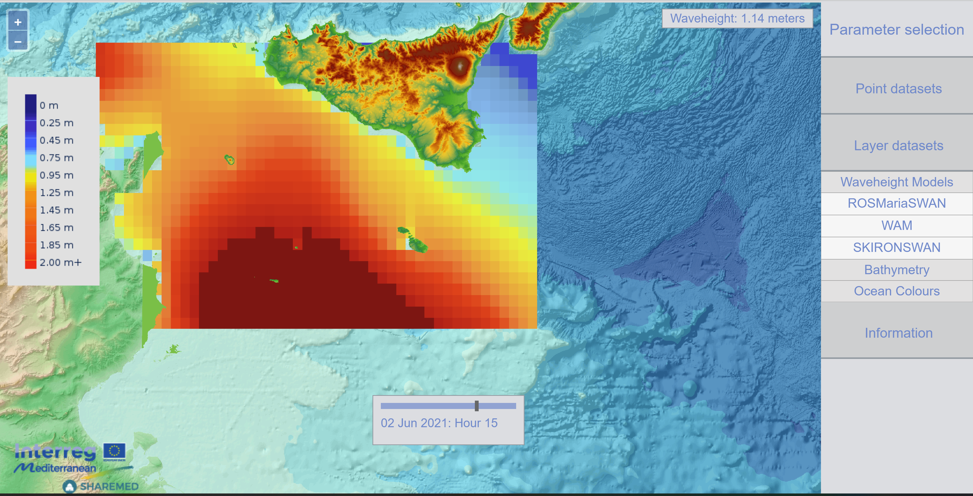
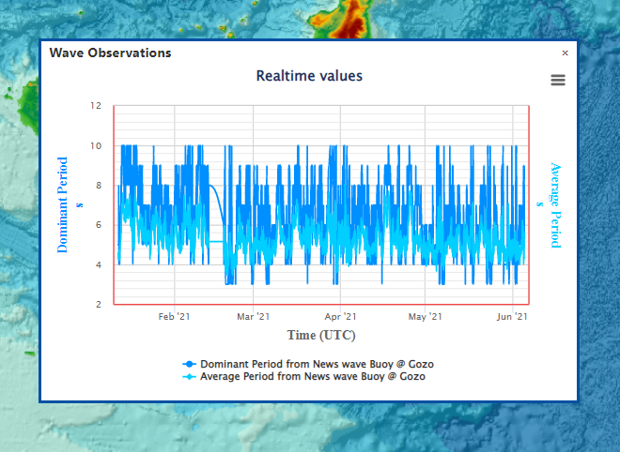
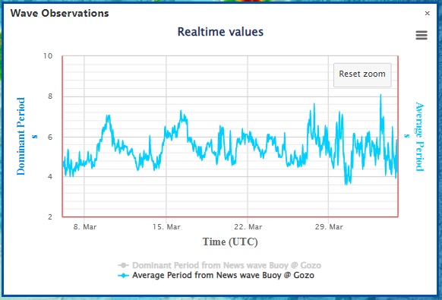
Sicily Channel Study Site
PORTAL sharemed.ocean.mt/sicilychannel

Slide 10
Sicily Channel Study Site
Some of the deliverables:
4.3.1 - Atlas of ecosystem status, pressures and environmental hazard index
4.4.1 - Common portals for the transnational pilot sites
4.5.1 - Implementation of the relocatable short-term forecasting system to study sites

Slide 11
Sicily Channel Study Site
ATLAS sharemed.ocean.mt/atlas
4.3.1 - Atlas of ecosystem status, pressures and environmental hazard index
[Serena Zunino, Donata Canu, Monica Previati, Audrey Zammit, Ankita Misra, Raisa Galea, Elena Zhuk, Anthony Galea]
University of Malta coordinated the production of data layers on the atlas especially in connection with marine heat waves.

Slide 12
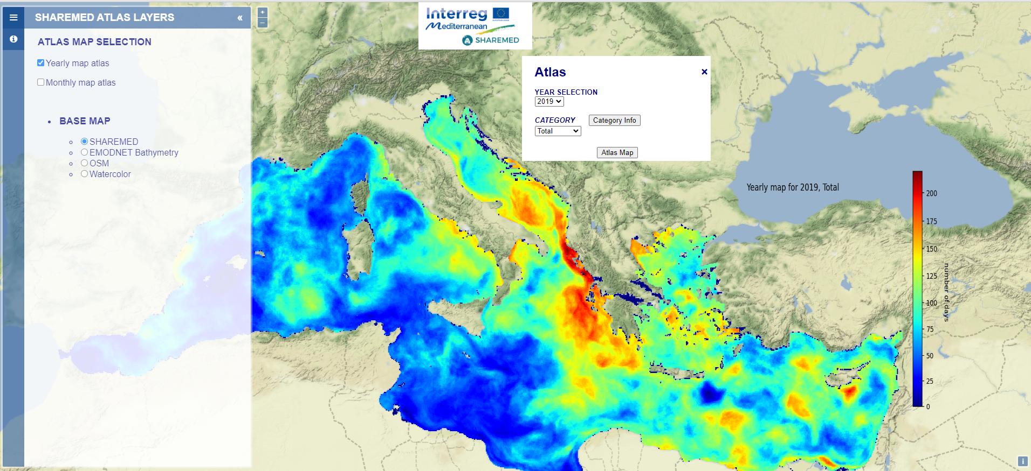
Sicily Channel Study Site
ATLAS sharemed.ocean.mt/atlas
Yearly
Marine Heat Waves selection (2019, Total)

Slide 13
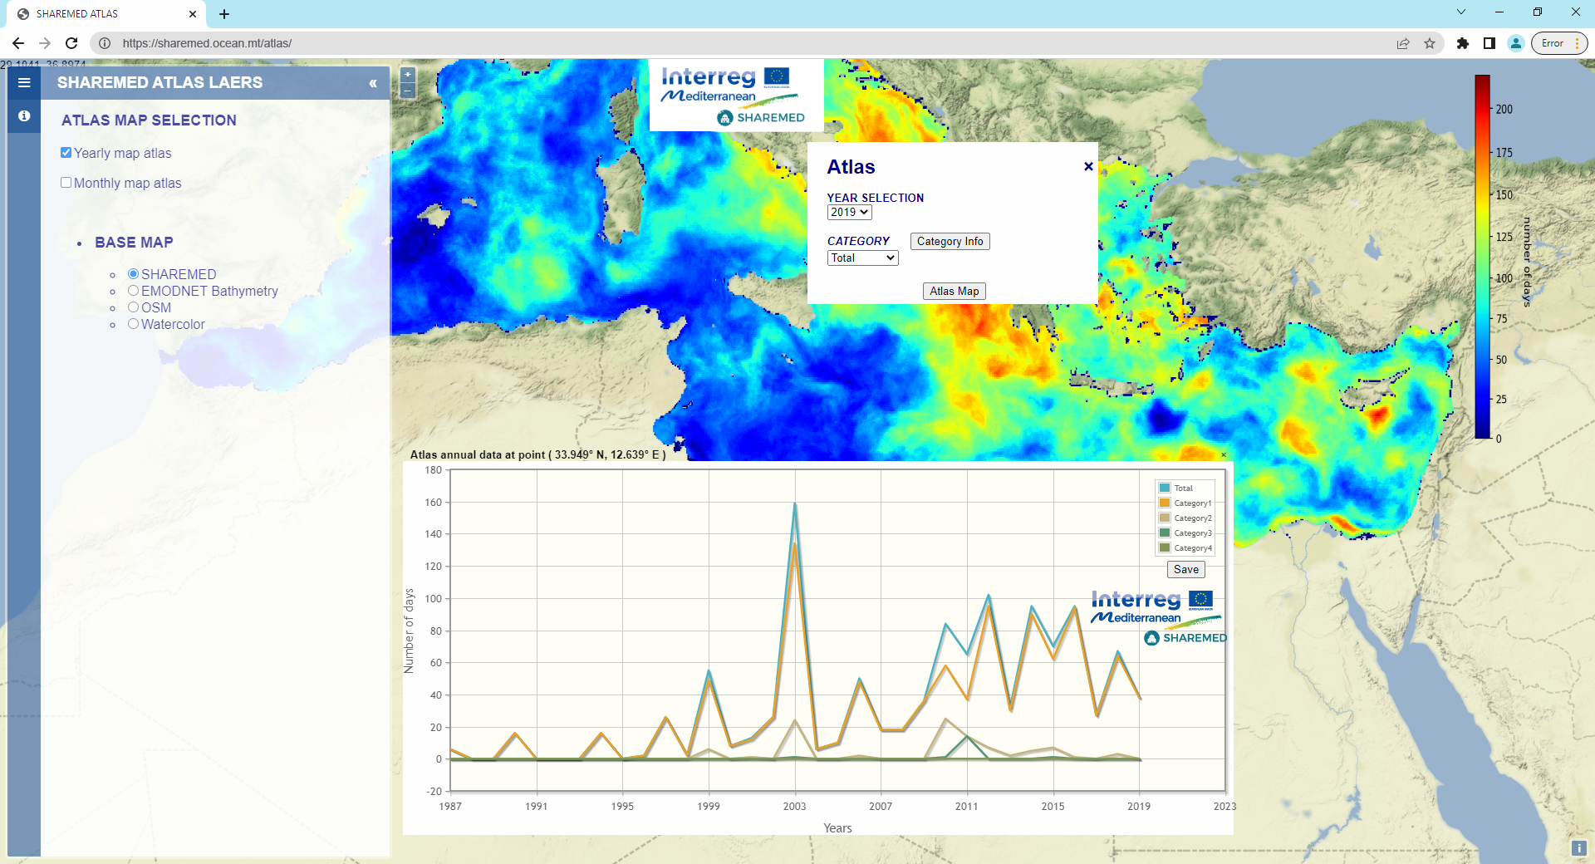
Sicily Channel Study Site
ATLAS sharemed.ocean.mt/atlas
Time series plot for 2019,
Total at point 33.949N, 12.639E

Slide 14
Sicily Channel Study Site
BGC MODEL
4.5.1 - Implementation of the relocatable short-term forecasting system to study sites
[Joel Azzopardi, Anthony Galea, Stefano Querin]
University of Malta was coordinating local staff to engage with support of Stefano Querin to implement this operational model at two resolutions in the Sicily Channel. Execution of this task is linked to the setting up of a HPC cluster.
Horizontal resolution: 1/64°(~1 nm)
Domain size: 432×544 grid points

Slide 15
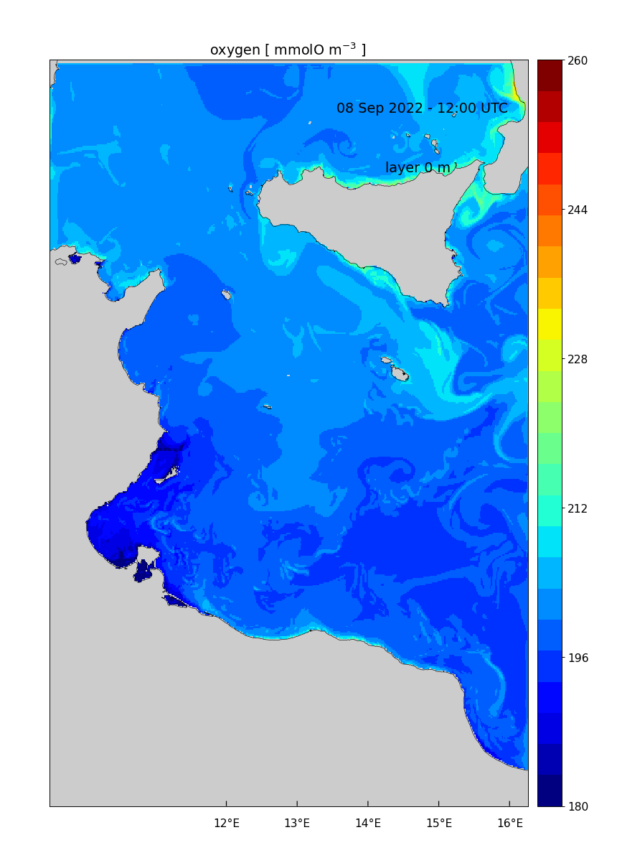
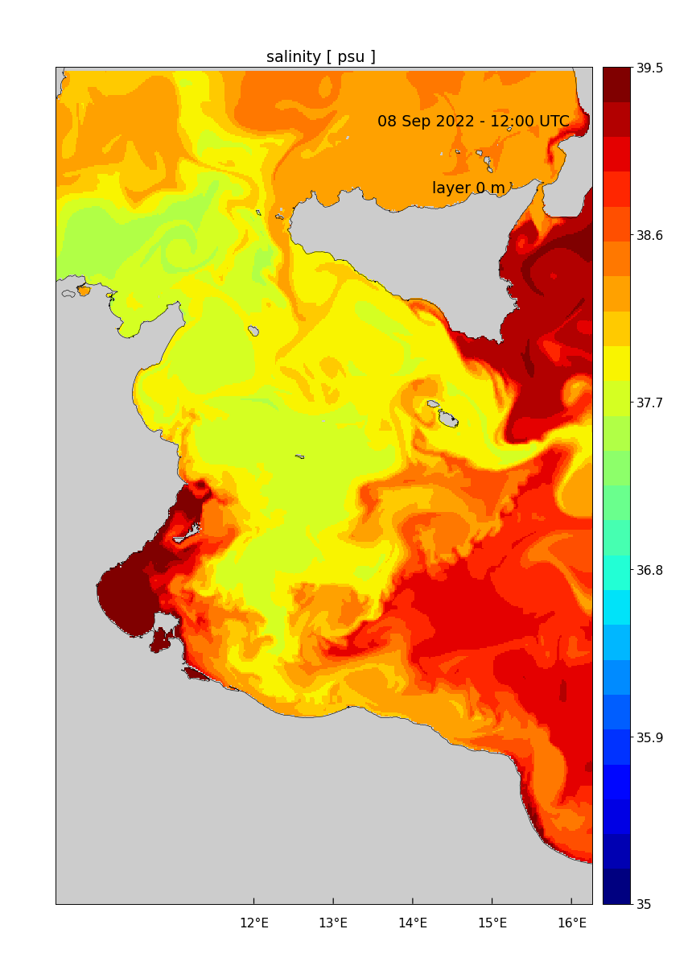
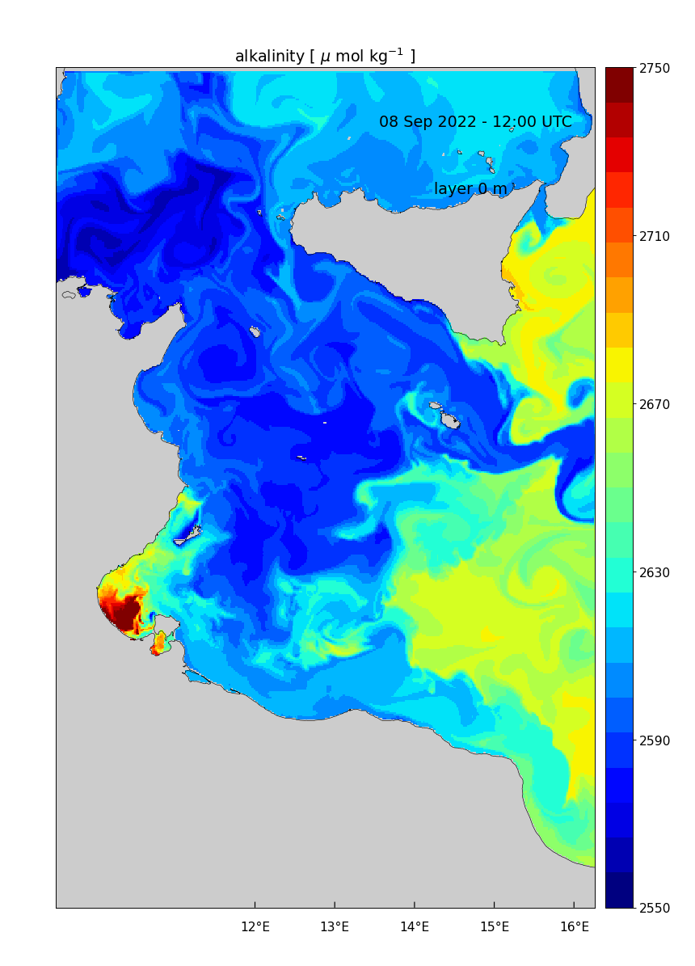
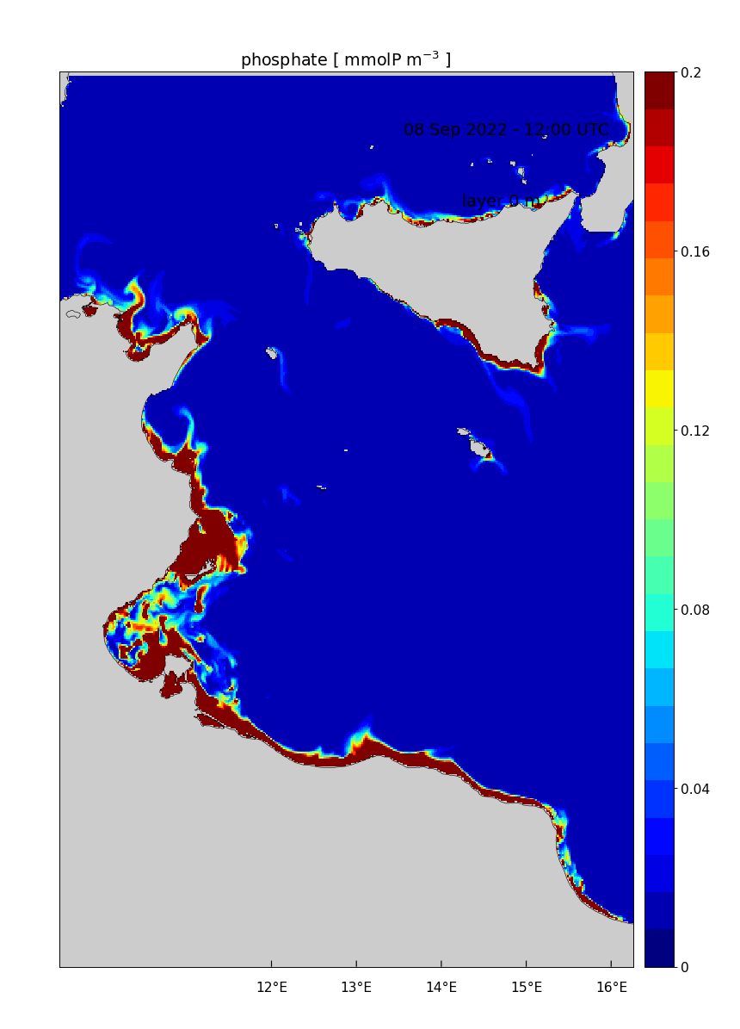
Sicily Channel Study Site
BGC MODEL
Examples of various parameters, forecast: 8th September 2022 at 1200

Slide 16
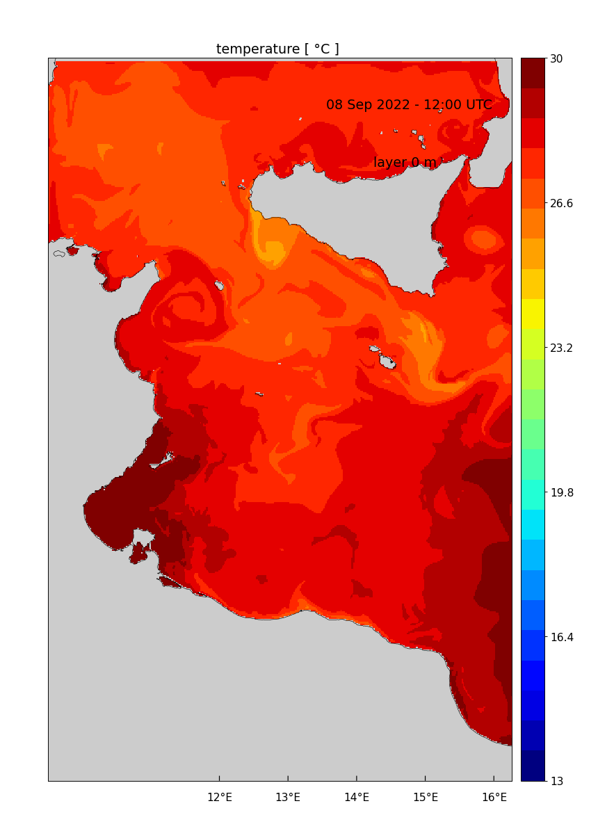
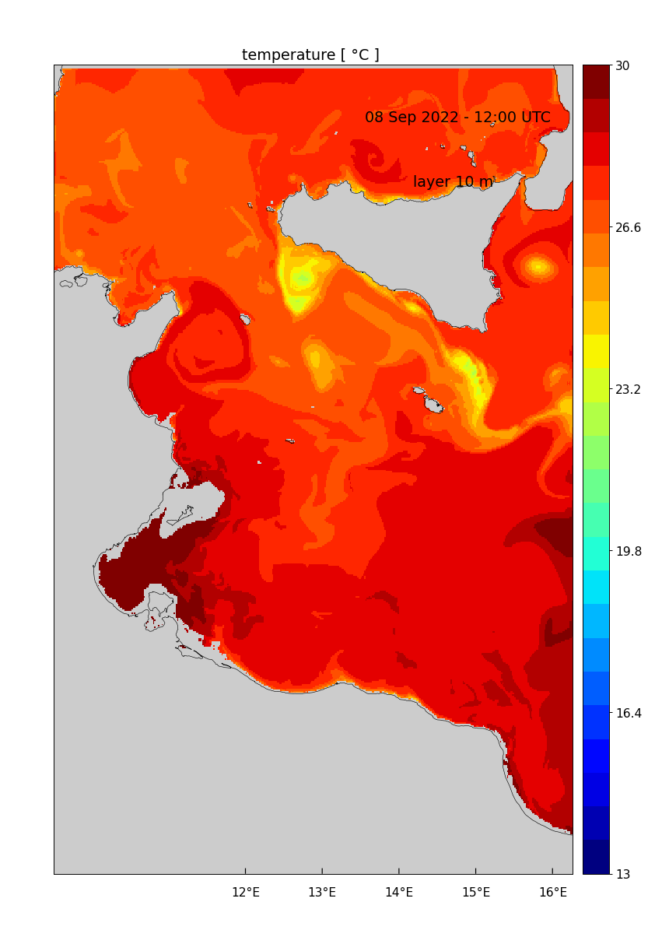
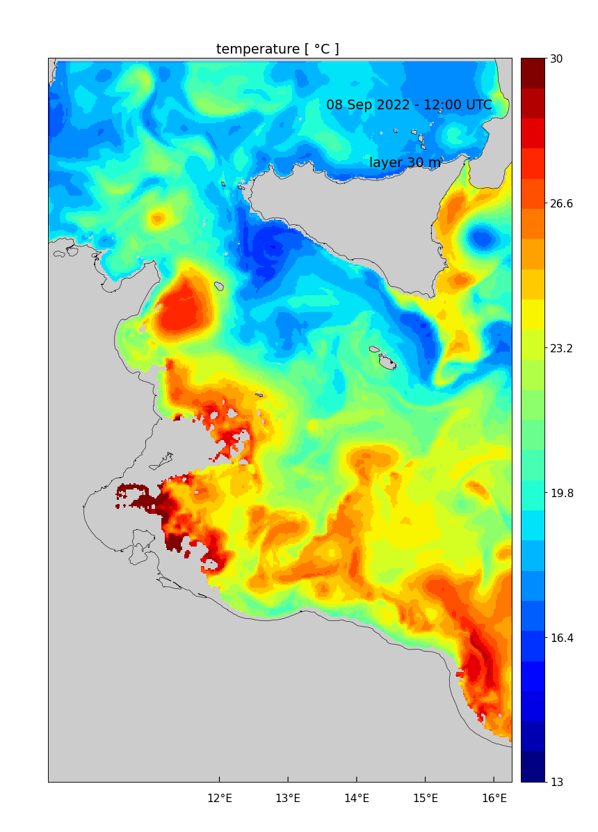
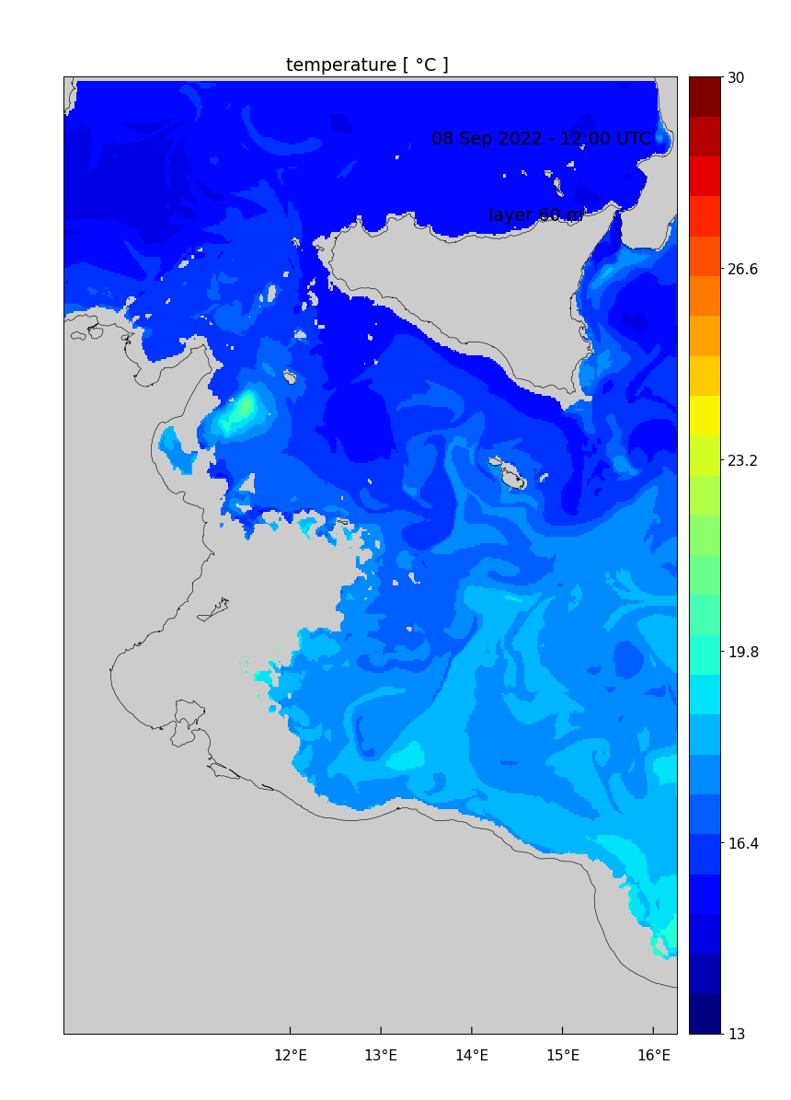
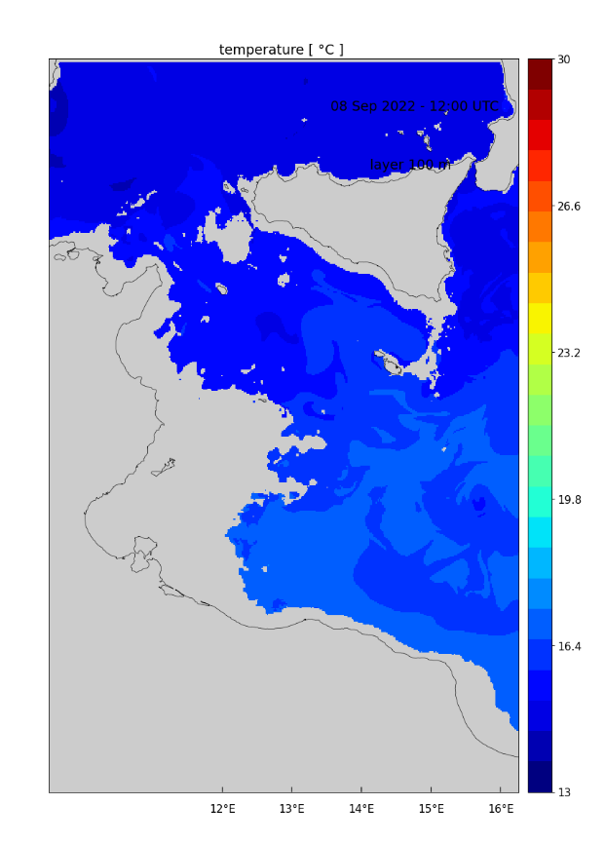
Sicily Channel Study Site
BGC MODEL
Examples of Sea Temperature at various depths,
forecast: 8th September 2022 at 1200

